Slide 1



Signet CRM
Submitted to:
Mr. Praveen Kumar Gupta
Presented By:
Ashu Tyagi, Ashutosh Khagwal

Slide 2
PURPOSE
The Software Requirement Specification (SRS) focuses on the Business Perspective as it contains details of the Business Solution for the Project. It captures functional Requirement for
Salesforce Implementation, CRM and Digital Platform for Customer, System Administrator.

Slide 3
Technology
Salesforce CRM –Signet Power using Salesforce CRM with Salesforce platform licenses.

Slide 4
Current State of Business
SIGNET POWER Signet Power very much appreciates your trust and patronage that you have been giving us since long.
Signet Power prides itself as one of the leaders in giving the best technological product to the customer, which are known for their world class quality, offering the complete range of Rittal and giving total solution for Electrical, Electronics, Process control Networking & telecommunication applications.
We have the wide and complete range; most of them ready stock thus giving you prompt delivery and hope that you will be able to meet your requirement as well as requirement of your customer even better.

Slide 5
Challenges
Maintain the Prospect/Customer data.
Complex Sales process.
Data is available on multiple platforms.
Follow-up based on dates.

Slide 6
MODULE DESCRIPTION
Module | Use Cases
User Management | UC-001
Lead Management | UC-002, UC-003, UC-004
Account Management | UC-005
Contact Management | UC-006
Opportunity Management | UC-007, UC-009
Product Management | UC-008
Quote Management | UC-010, UC-011
Case Management | UC-012
Activity Management | UC-013
Reports & Dashboard | UC-014

Slide 7
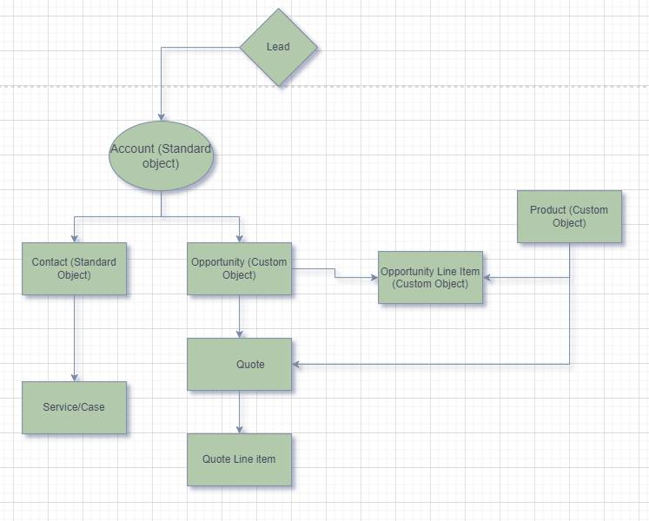
Flow Chart

Slide 8
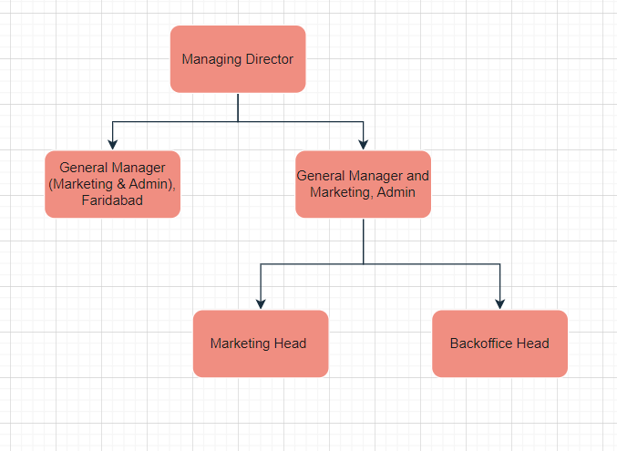
Organizational Structure

Slide 9
THANK YOU

